Slide 1
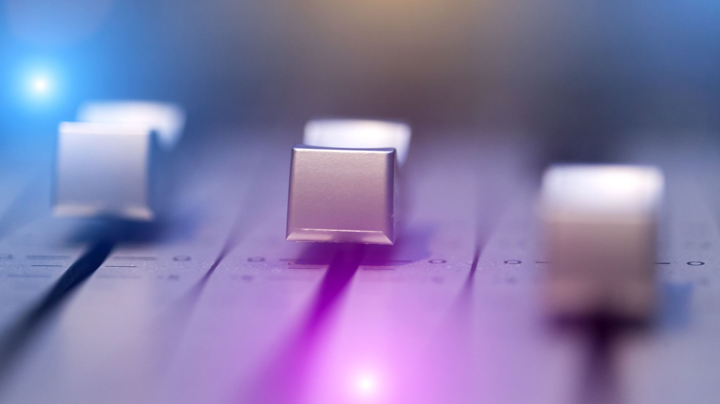
Psychophysics of the basic sound dimensions: Loudness

Slide 2
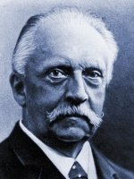
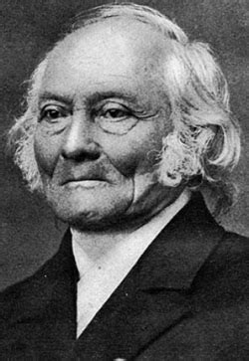
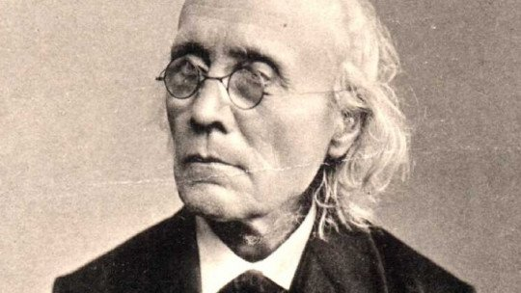
Psychophysics
Hermann von Helmholtz (1821-1894)
Ernst Heinrich Weber (1795-1878)
Gustav Theodor Fechner (1801-1887)

Slide 3
Physical and perceptual features of sounds
Waveform amplitude -> Loudness
(the larger, the louder)
Waveform period -> Pitch
(the longer, the lower)
Waveform shape -> Timbre
(the more “rippled” –far from sinusoidal-, the richer)

Slide 4
Psychophysical Laws
Mathematical expressions relating a physical property with a perceptual sensation
Response =
f (sensory stimulation)
Is f linear, potential, exponential?
Are sensations totally independent?
Collect “subjective” judgments when presenting different intensities, pitches, along a single dimension
Find the best fit between the physical magnitudes and the perceptual estimations

Slide 5
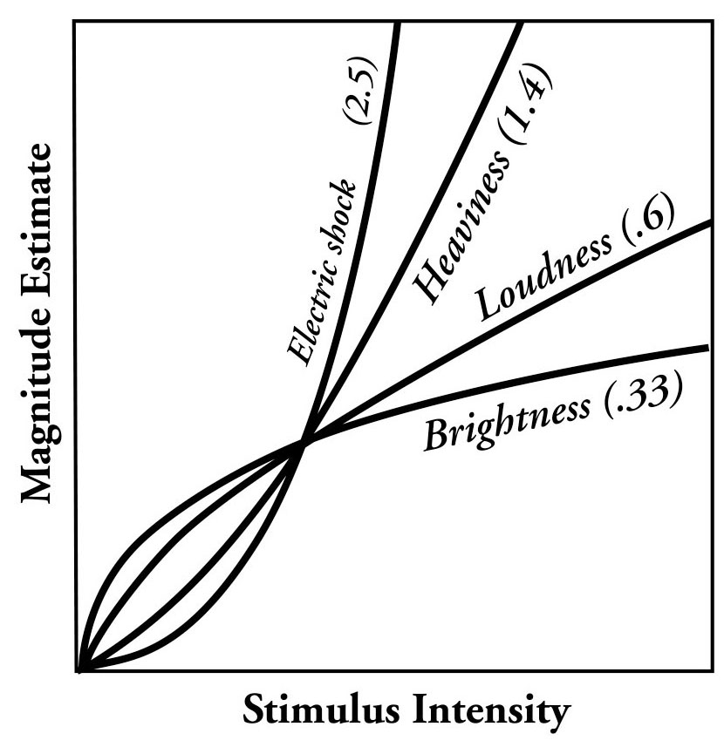
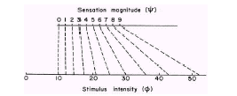
Psychophysical Laws
1831
Weber’s Law : ΔI/I = k
The just-detectable change in stimulus intensity (JND or DL) is proportional to the intensity
1860
Fechner’s Law : R = k log(I)
R is the sensation, I is the physical property, k a constant to be found or adjusted from the data
1957
Stevens’ Power Law :
R = kI^{p}

Slide 6
Absolute thresholds
Can you hear a sound?
Can you hear a pitch?
Can you feel pain?
Can you see a light?
Which is the minimum amount of stimulation needed to feel a given sensation?

Slide 7
Differential thresholds
Which is the minimum difference that can be perceived with relation to a given sensation?
“Just noticeable difference” (JND), “Differential threshold”, or “Differential Limen (DL)
Listen one sound, then another, then decide if they are the same or are different.
The first difference or jump that is noticed by more than 75% of the listeners is the JND for that sensation

Slide 8

Musical Pause

Slide 9
Loudness
The subjective sensation generated by the intensity of the air pressure
loudness
Loudness
?
amplitude
Pressure (dB)
Notes:
In this section, we will be looking at how the auditory system codes frequency information
much of what we know in this area comes from studies involving the process of masking
masking is the process by which the simultaneous presence of one sound elevates the threshold (changes the audibility or sensitivity) of another
distinguish this from fatigue
the way various signals mask another tells us a lot about how the auditory system analyzes the frequency components of a sound

Slide 10
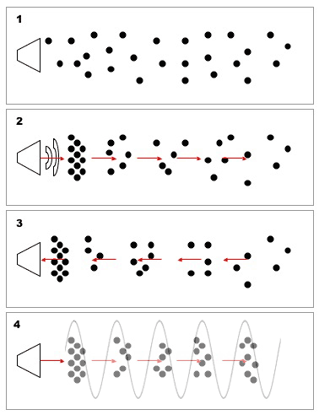
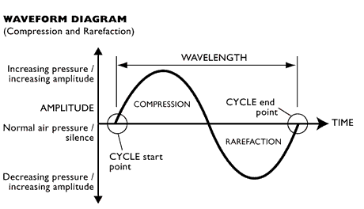
Compression and rarefaction

Slide 11
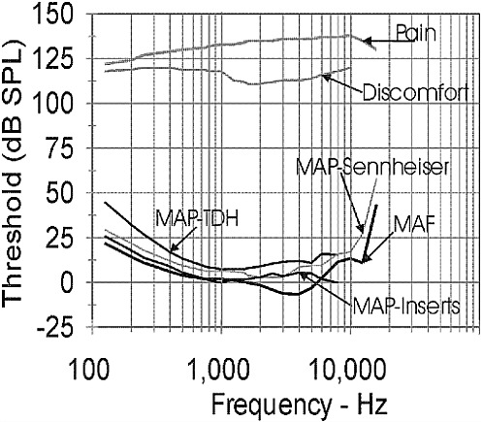
Absolute thresholds
Different measurement conditions yield slightly different curves

Slide 12
The dB_{SPL}
Unit preferred to measure the Sound Pressure Level:
dB_{SPL} = 20 log(P/P₀)
It usually ranges from 0 to 130
Uses the minimum audible pressure for 1KHz as reference value (P₀ )
What does 0dB_{SPL} mean? No pressure?
And negative dB_{SPL}?
dBs are not additive (20dB+20dB<>40dB)
Convert dB_{SPL} to Pressure: P = P₀ • 10^{(dB/20)}

Slide 13
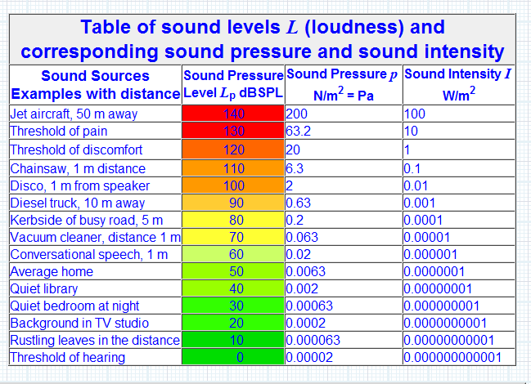
The dB_{SPL}
Avoid recurrent events generating >90dBSPL
(avoid physical damage of hair cells)
Negative dBSPL?
http://www.sengpielaudio.com/calculator-soundlevel.htm

Slide 14
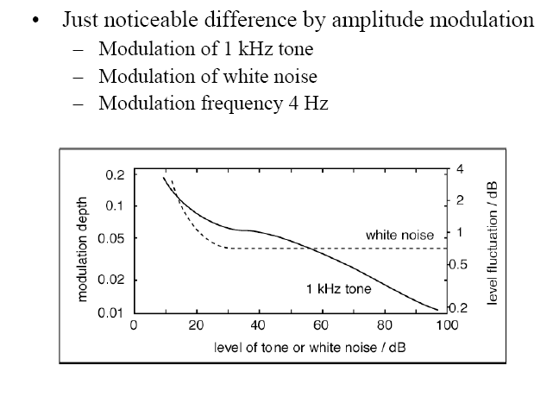
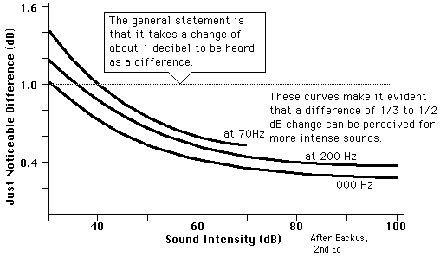
Differential thresholds

Slide 15
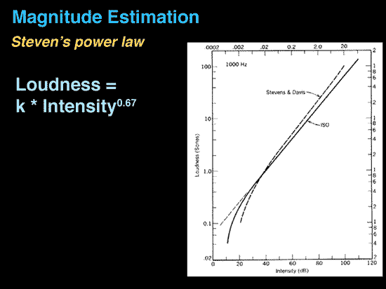
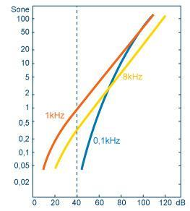
Sones
Subjective scale for loudness
How much louder a sound is than another one?
1 Sone=loudness sensation for 1KHz @ 40dB_{SPL}
A 10 dB increase in level gives a doubling in loudness
Which is the loudness of 1KHz @ 60 dB_{SPL} ?

Slide 16
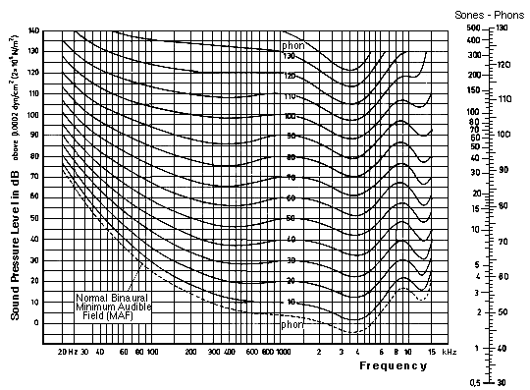
Phones
Equal loudness, isophonic, or Fletcher & Munson curves
How much do we need to amplify/attenuate a tone to get “equal loudness” between both?
Tones with equal loudness have the same phon level
“Loudness” function in hi-fi amplifiers and in music player presets
http://www.wolframalpha.com/widgets/gallery/view.jsp?id=89a26a363b87a87ac6a94277e841b7f4
Which of the two series sounds more isophonic?

Slide 17
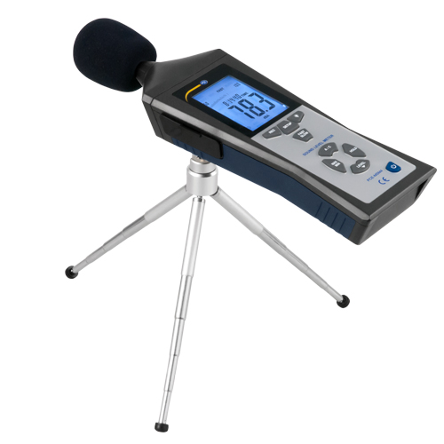
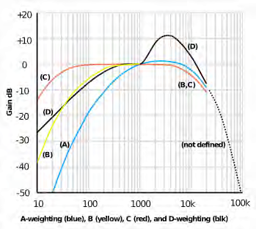
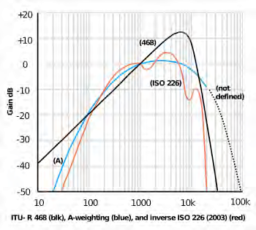
Loudness weighting scales
dB(A) = 40 phon curve (approx.) ||| dB(B) = 70 phon curve ||| dB(C) = essentially flat, for high pressure levels

Slide 18
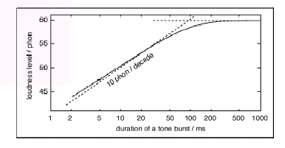
Loudness and duration
Energy integration time < 150ms
The longer the tone, the louder, up to 150ms

Slide 19
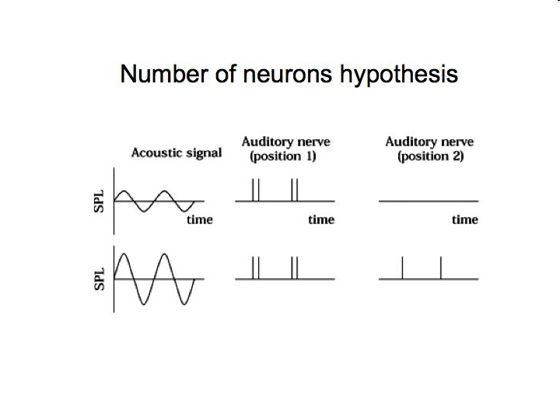
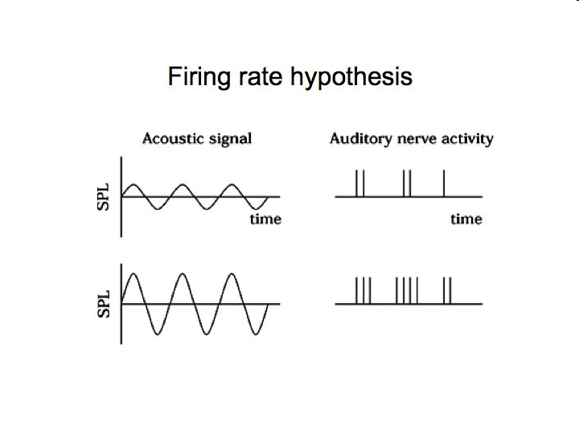
Neural coding of intensity
Firing rate works for low intensities
Number of neurons works for mid-loud intensities

Slide 20
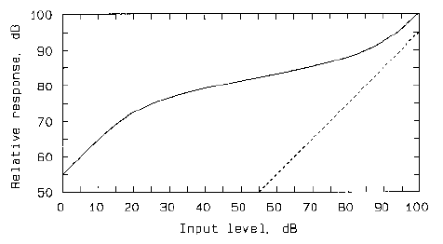
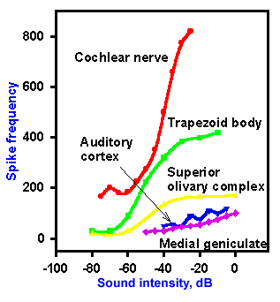
Neural coding of intensity
Cochlear damage
Compression caused by the basilar membrane
Intensity is mostly encoded in the early transmission through the auditory pathways

Slide 21
Loudness of complex sounds
Does loudness increase by adding energy at any place in the spectrum?
Are this 2 tones isophonic?
500, 520, 540 Hz
500, 720, 940 Hz
We must consider the frequency resolution of our hearing system

Slide 22
Auditory filters and loudness
Level
(dB)
62
65 phons
62
65 phons
Level
(dB)
1.1 1.15
1.1 1.25
Freq (kHz)
Relative
amplitude (dB)
Freq (kHz)
Relative
amplitude (dB)
794 1000 1260 1588
794 1000 1260 1588
Frequency (kHz)
Frequency (kHz)
70 phons
Level
(dB)
62
1.1 1.5
Freq (kHz)
Relative
amplitude (dB)
794 1000 1260 1588
Frequency (kHz)
Notes:
This effect seems counterintuitive, but it appears that the same (clearly audible) sound energy spread over multiple filters sounds louder than when the same sound energy falls within a single filter.

Slide 23
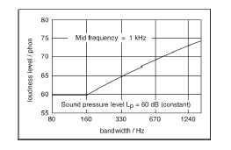
Loudness of complex sounds
Peripheral processing (filtering according to the outer and middle ear specificities)
Computation of the excitation pattern considering the masking effects (cochlea + neural firing approximation)
Conversion of the excitation pattern into band-specific loudness computation
Summation of the specific band-loudness into the final loudness value
CB for 1KHz
Loudness increases (additively) only when there is energy beyond the critical band

Slide 24
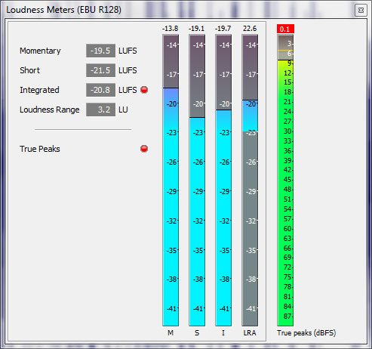
Approximating loudness: LUFS (EBU-128)
Better option than dBFS (Peaks) or RMS values

Slide 25
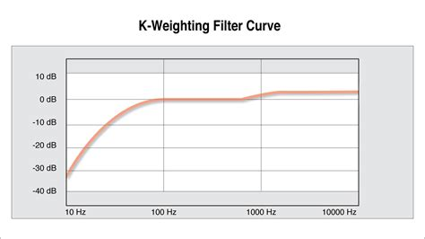
LUFS (EBU-128)
Weighting curve roughly based on our hearing

Slide 26
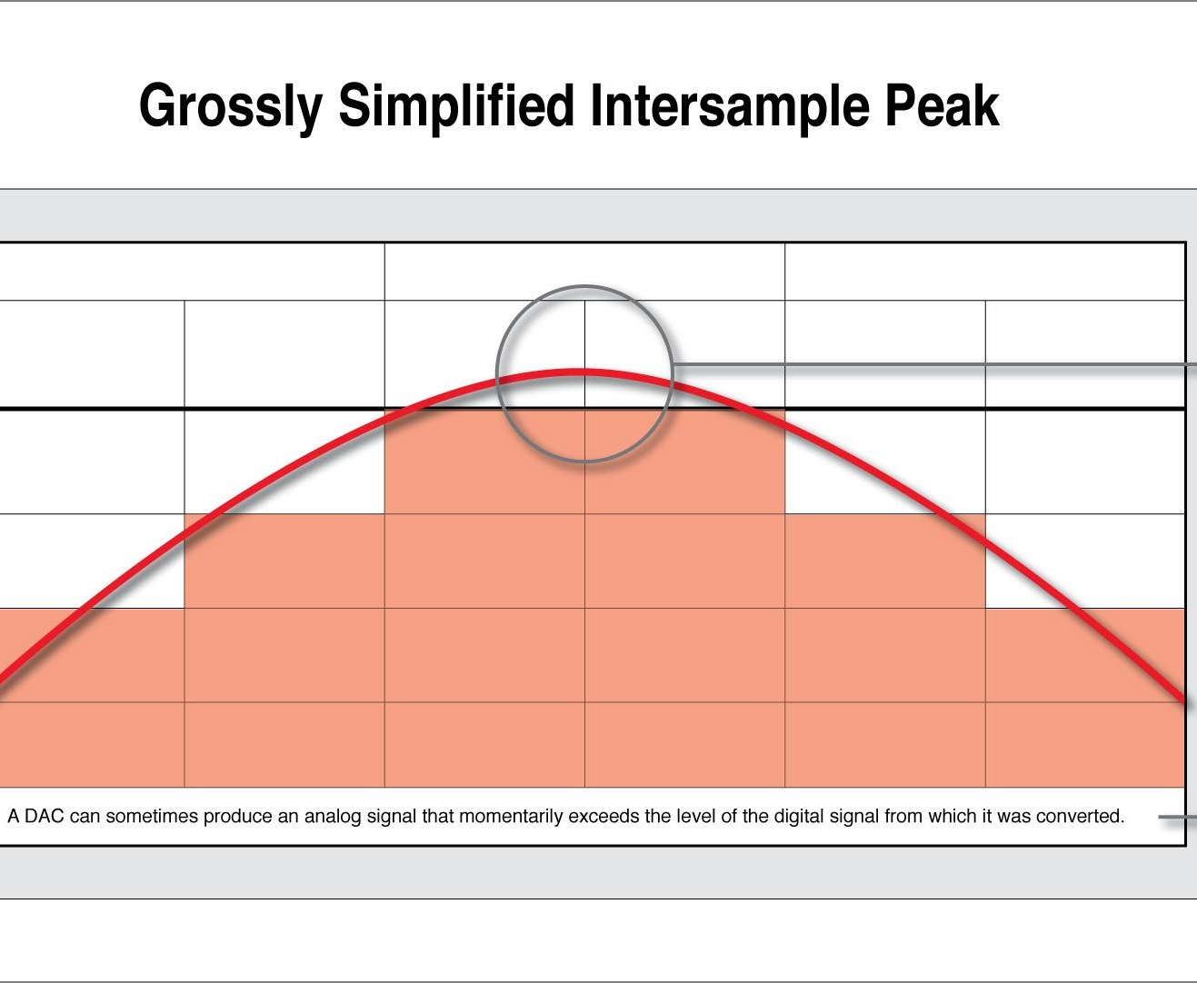
LUFS
True Peak: oversamples the data to interpolate if the reconstructed analog waveform could go beyond 0dBFS

Slide 27
LUFS
Momentary loudness: K-weighted RMS in 400ms
Short-term loudness: integrated loudness in 3 seconds’ windows
Integrated loudness: average loudness for a whole track
Loudness range (LRA): statistical distribution of short-term loudness within a track

Slide 28
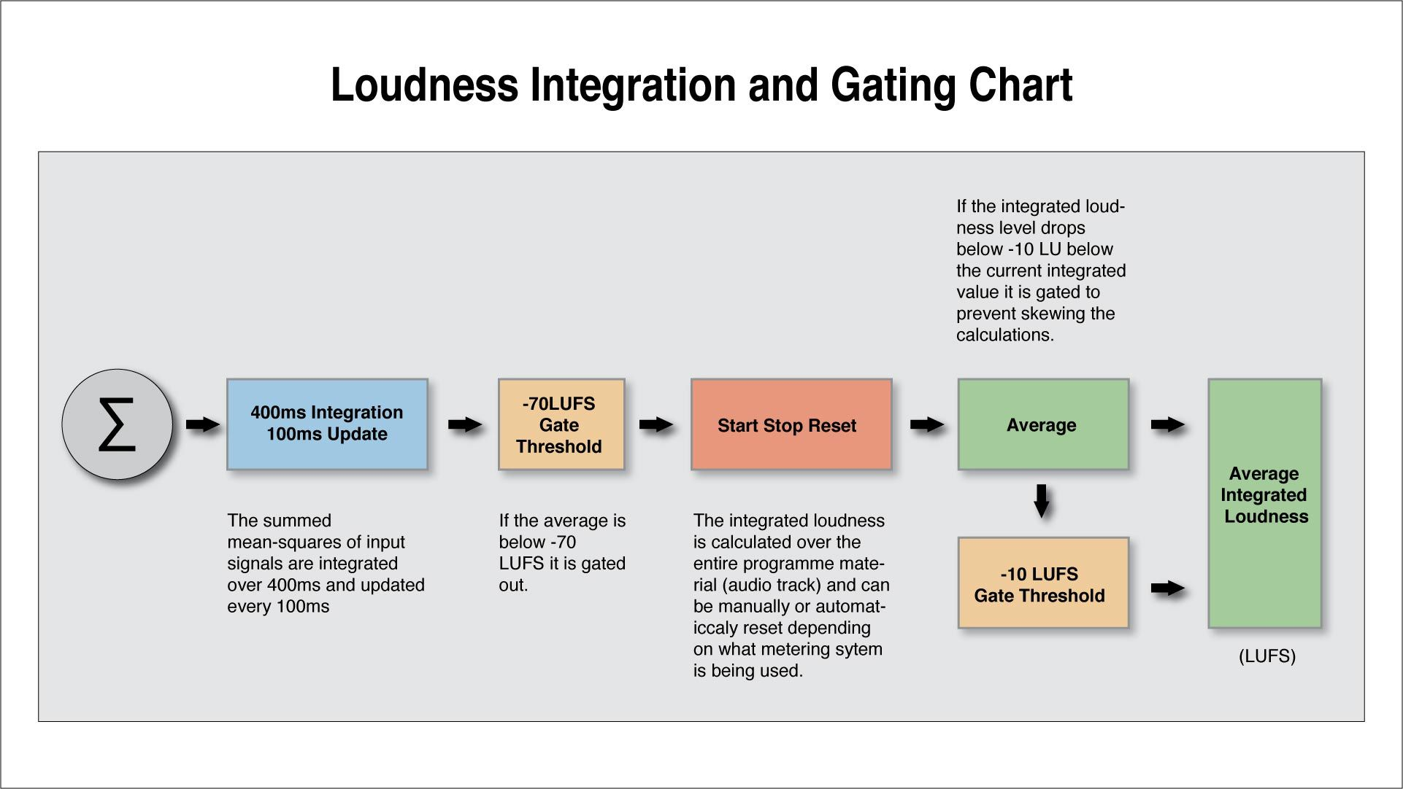
LUFS

Slide 29
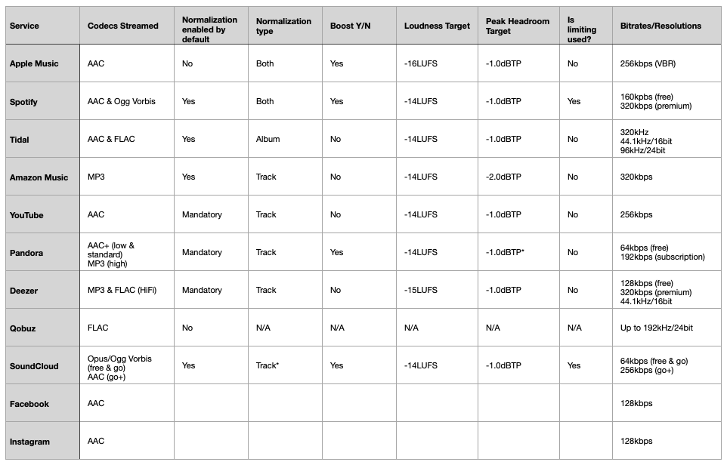
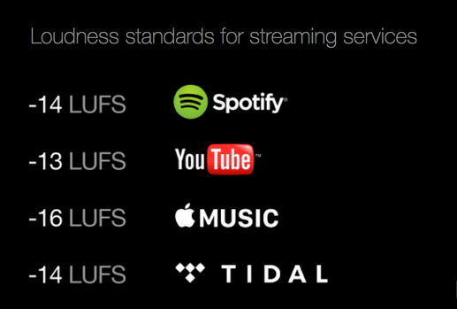
LUFS
Targeted values in streaming platforms

